Slide 1
Predicting the response rate on Stack Overflow with Google BigQuery
Varuni Dantanarayana
Capstone Project 1
Springboard

Slide 2
Introduction
Stack Overflow is the number one resource used by coders worldwide
Provides a great source of information from beginner to advanced level programming questions under a variety of topics
Real-world data set published publicly on Google BigQuery (contains 16 tables with number of rows ranging from 4-32 million)
Goal: Predict the response time based on various features of a question posted on Stack Overflow
Benefits: Stack Overflow users, i.e. ~10 million registered users as of 2019 and more than 50 million visitors every month

Slide 3
Data Acquisition
Published on the Google Cloud Platform
Direct analysis on BigQuery console in SQL
To access from Jupyter notebook:
1) Enable Google BigQuery API on the Google Cloud Platform
2) Get authentication for Jupyter Notebook by obtaining a service account key for the BigQuery in a JSON file
3) Install Google BigQuery API client libraries for Python on local computer

Slide 4
Exploratory Data Analysis

Slide 5
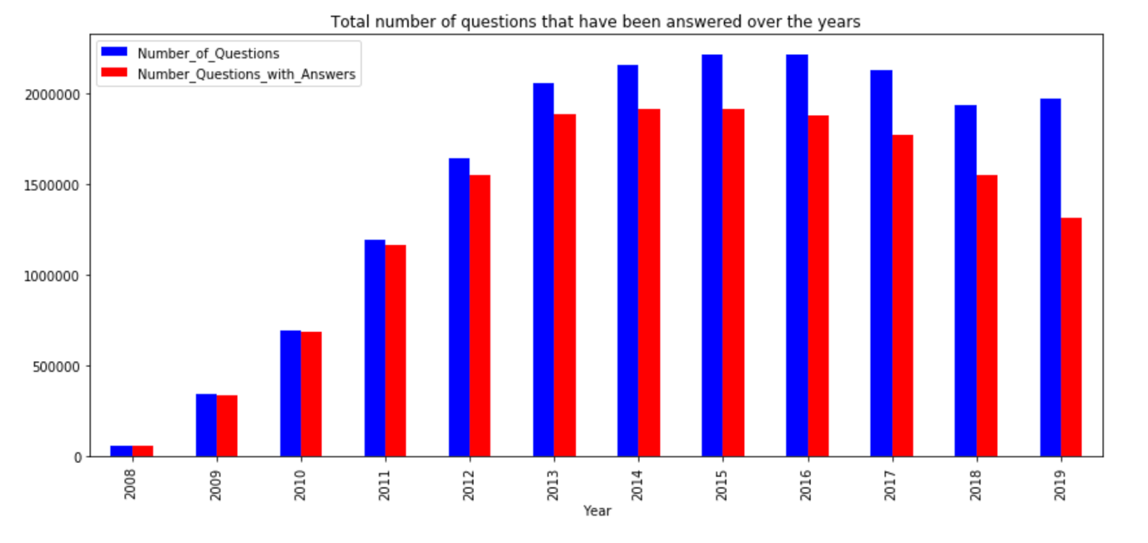
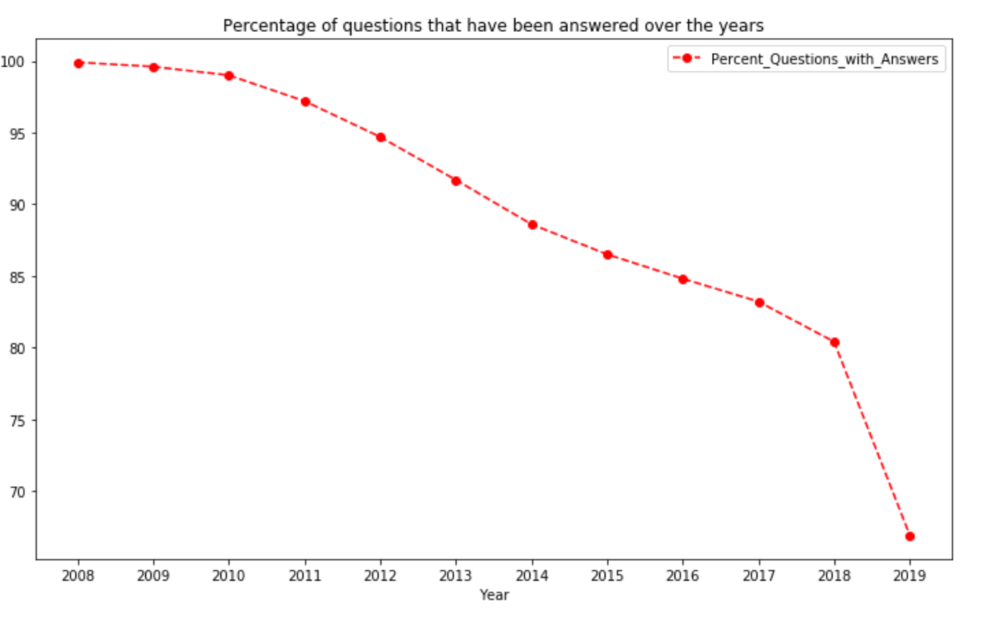
Questions that got answers over the years
Almost 100% of the questions have been answered in the starting years of StackOverflow till 2010
% of questions without answers increases
Highest % of unanswered questions in 2019

Slide 6
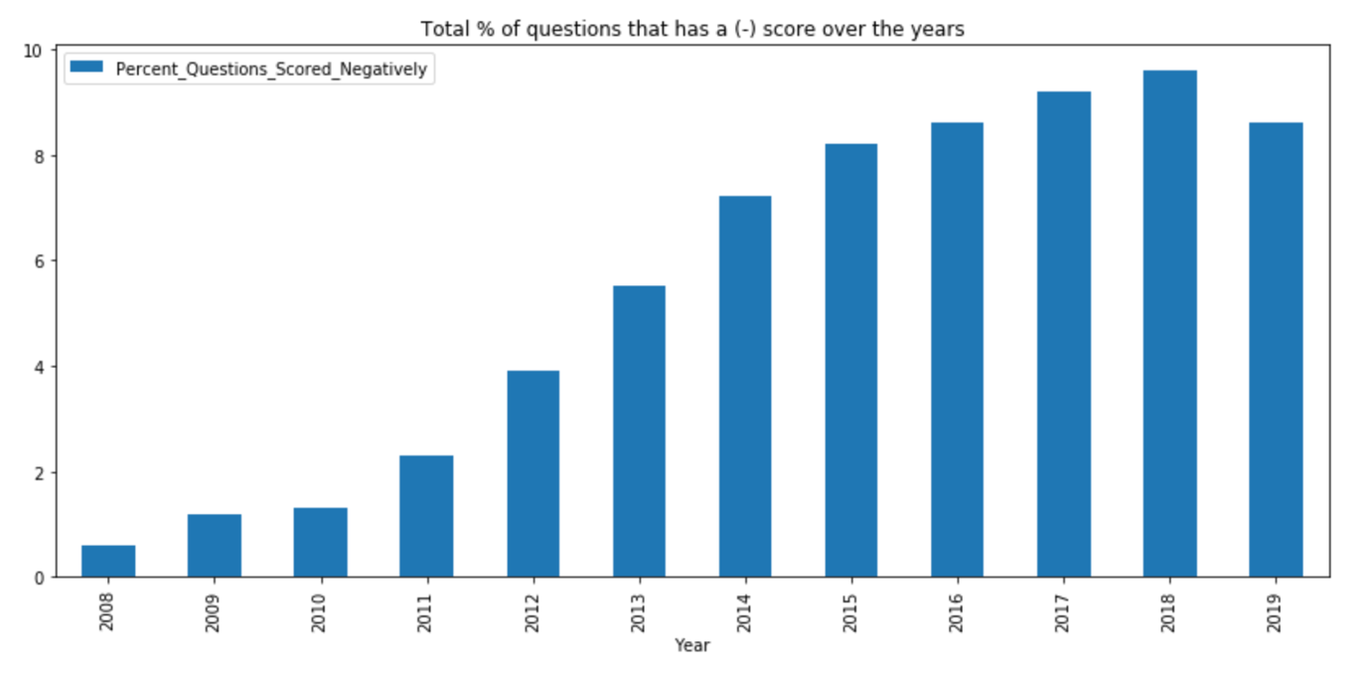
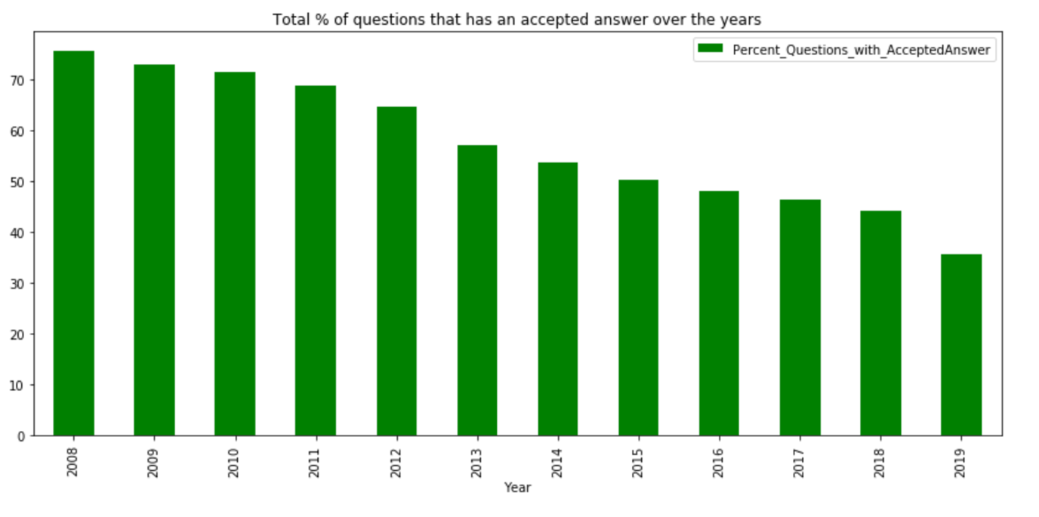
Distribution of answer quality
The percentage of negatively scored questions show a general upward trend till 2018 and decrease in 2019
General downward trend of the percentage of questions with an accepted answer from 2008 and significant drop going from 2018 to 2019
High percentage of unanswered questions in 2019 is due to the lack of unaccepted answers and not as a result of negatively scored questions

Slide 7
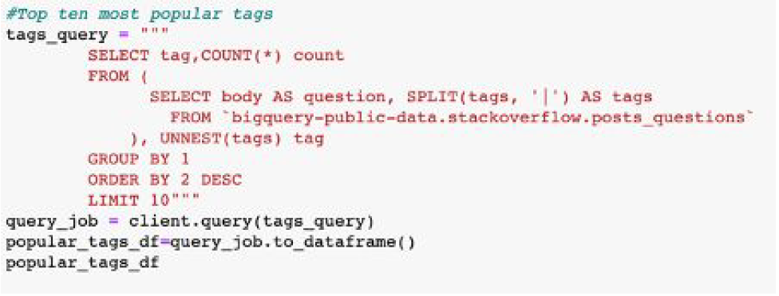
Top ten most popular tags and gold badges
Tag | Count
Javascript | 1909607
Java | 1613271
C# | 1363741
Php | 1320047
Python | 1297726
Android | 1237162
Jquery | 9714118
Html | 863493
C++ | 644513
Ios | 615317
Javascript is the most popular tag on Stack Overflow with over a 18% margin over the second most popular tag, Java.
In fact, three out of the ten most popular tags are related to Java-the Java community seems to have a lot of technical questions!
Badge name | Count
Famous Question | 668653
Great Answer | 77521
Great Question | 35936
Fanatic | 33217
Unsung Hero | 22120
Electorate | 21201
Populist | 20924
Steward | 14158
Stellar Question | 7725
Socratic | 4070

Slide 8
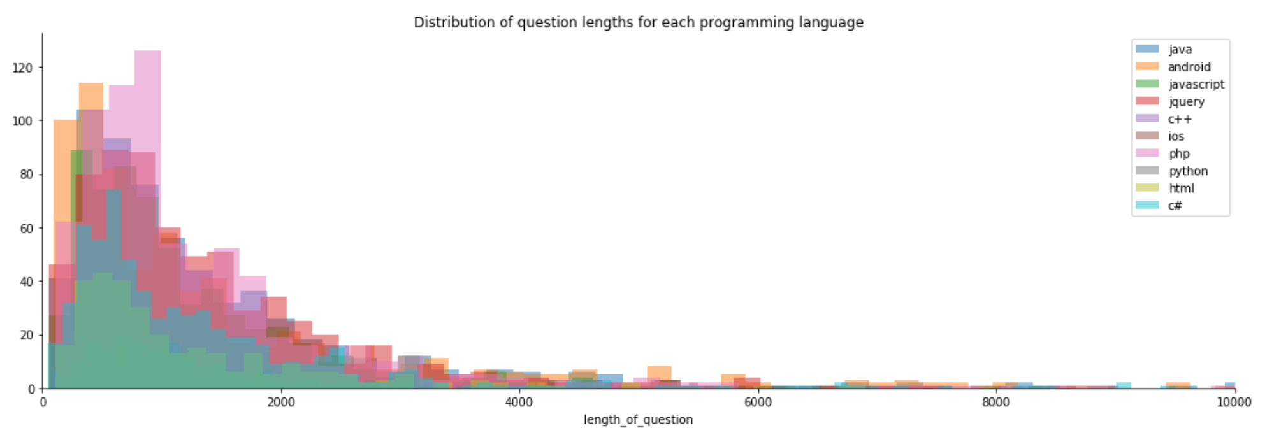
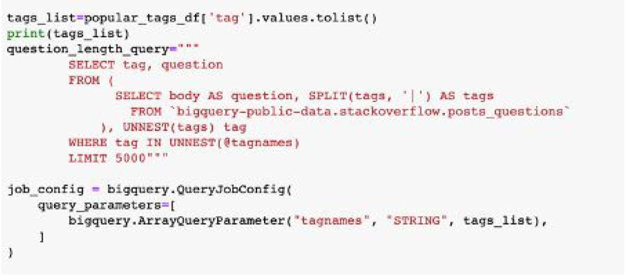
Avg question length distribution

Slide 9
Data wrangling
1) bigquery-public-data.stackoverflow.posts_questions
2) bigquery-public-data.stackoverflow.posts_answers
3) bigquery-public-data.stackoverflow.users
Above tables were joined using Standard SQL to create relevant features about questions
Dataset containing ~70,000 rows
Missing values (present in the dependent variable) were dropped

Slide 10
Feature Engineering
Starting word
Ends with a question mark
Length of each question (short if <700 characters, medium if <1700 characters, long if >1700 characters)
Day of week
Time of day it was posted
User account creation date
Tags: 'python', 'r','mysql', 'machine-learning','data-science’
Questions posted after 2016
Time taken for the first answer: dependent variable

Slide 11
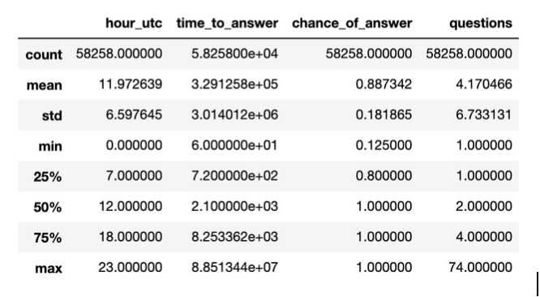
Numerical feature analysis
50% of the questions get asked before noon and 75% of the questions get asked before 5pm
More that 50% of the questions have a 100% chance of getting answered

Slide 12
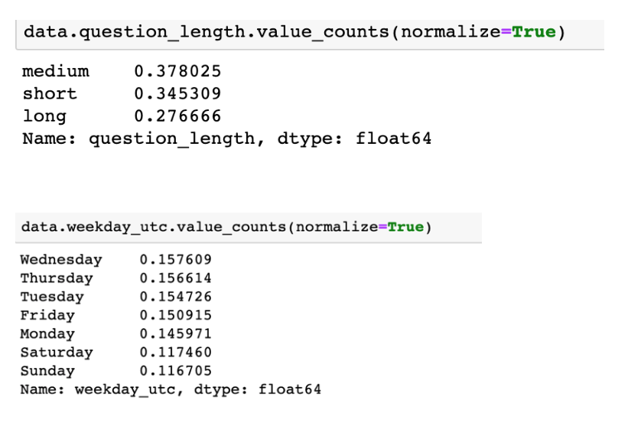
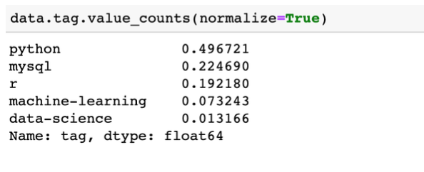
Categorical feature analysis
Most questions are of medium length (i.e. total number of characters between 700-1700)
Most question get posted on Wednesday
Long questions (over 1700 characters) are not as common and least number of questions get posted over the weekend
Python is the most common tag out of the selected data science-y ones picked

Slide 13
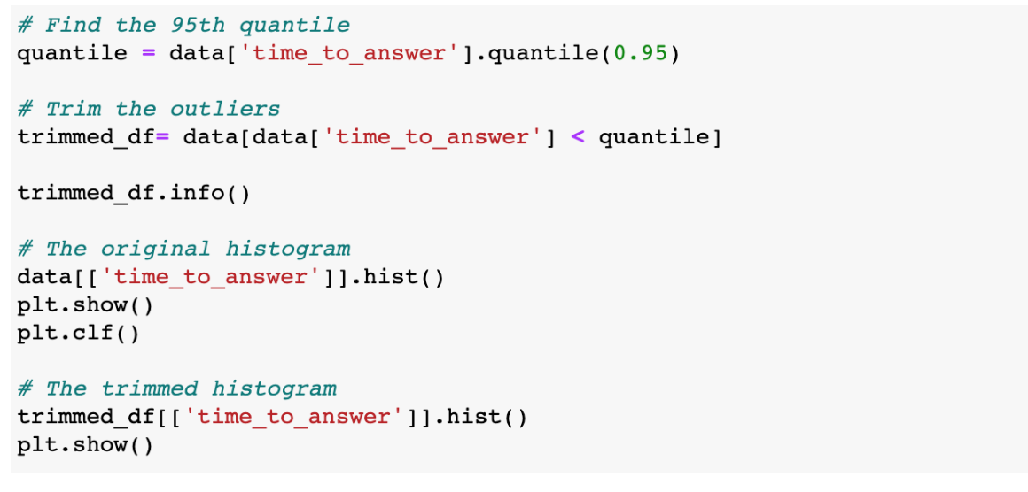
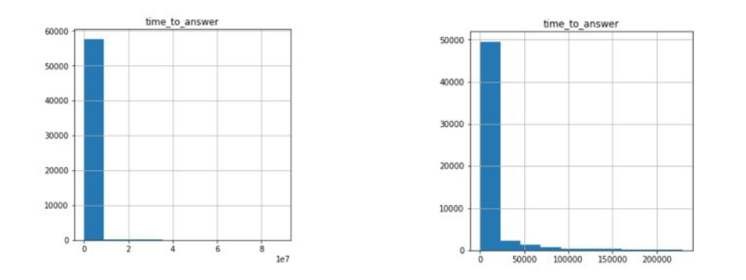
Outlier removal
Dependent variable has a wide range of 60-8.8⁷, highly right-skewed
Percentage based outlier removal at the 95% percentile

Slide 14
Machine Learning Models

Slide 15
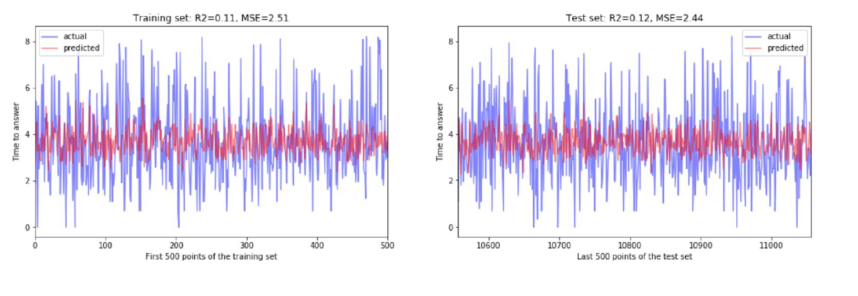
Linear Models
Linear Regression:

Slide 16
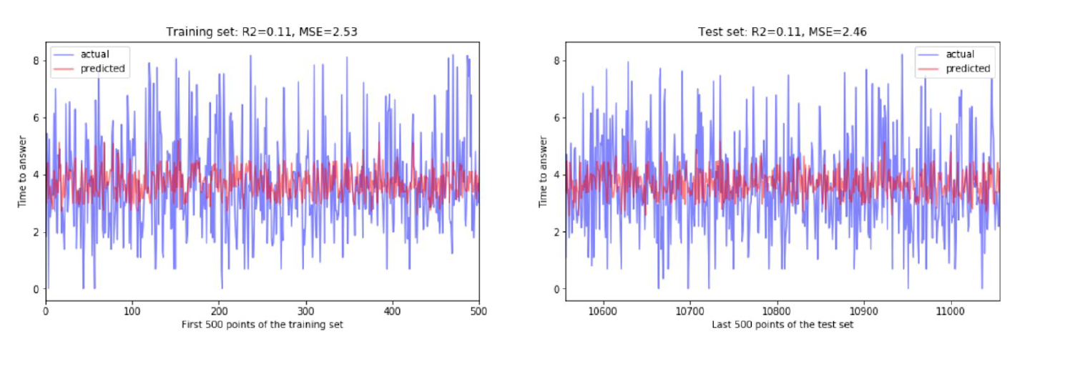
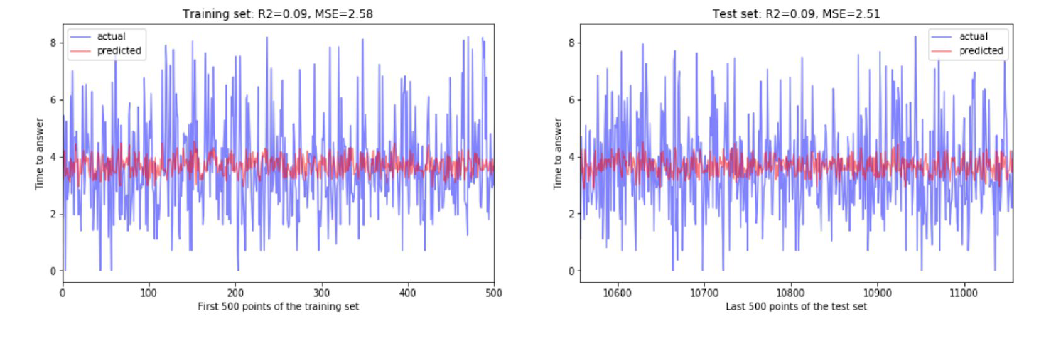
Linear Regression w/
Lasso Regularization:
Linear Regression w/
Ridge Regularization:

Slide 17
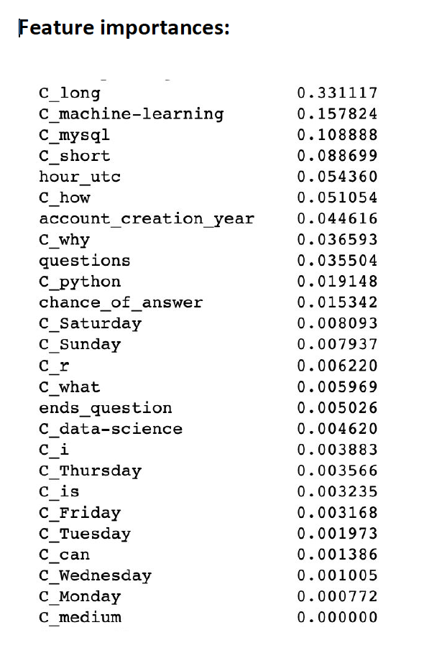
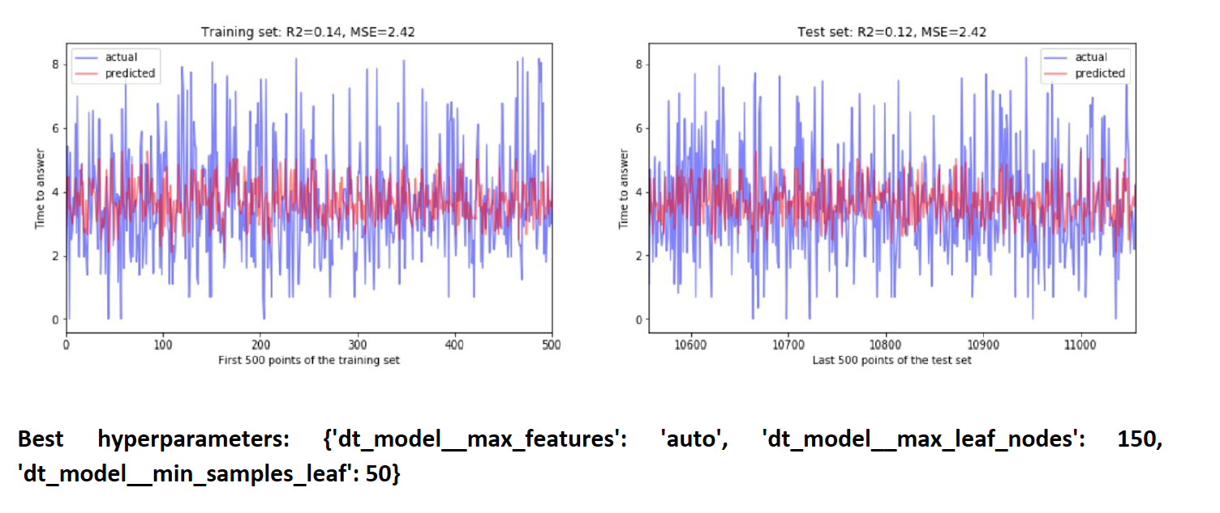
Tree-based Models w/ 5-fold CV and Hyperparameter Tuning
Decision Tree:

Slide 18
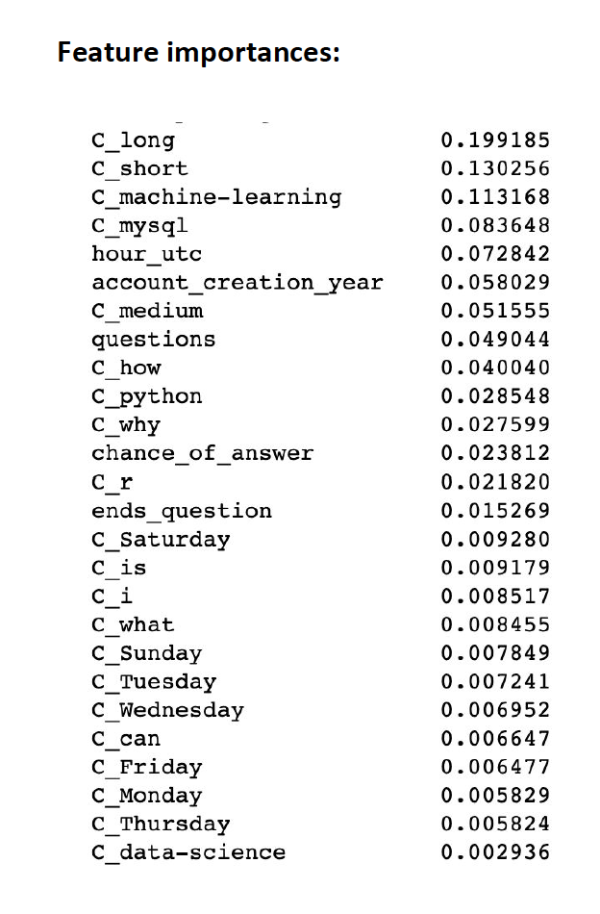
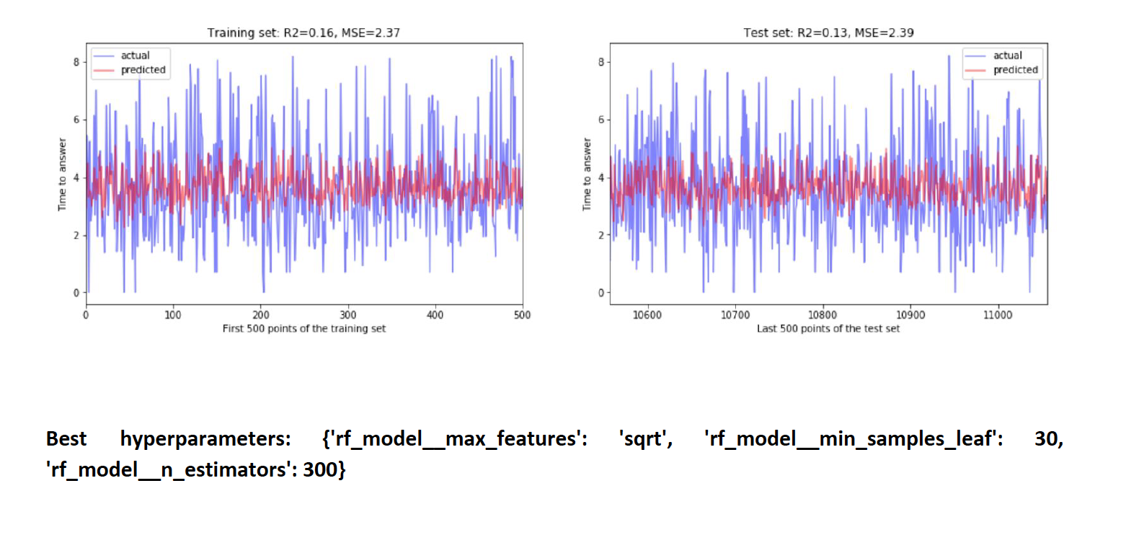
Random Forest:

Slide 19
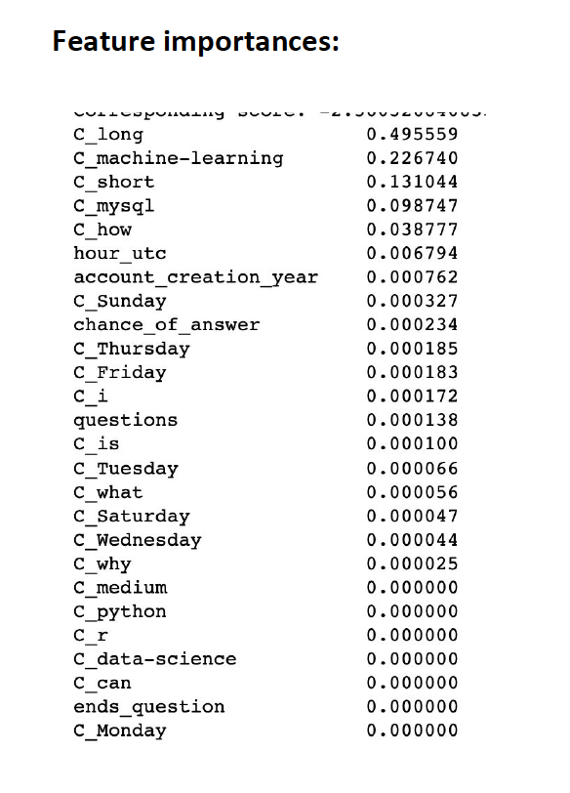
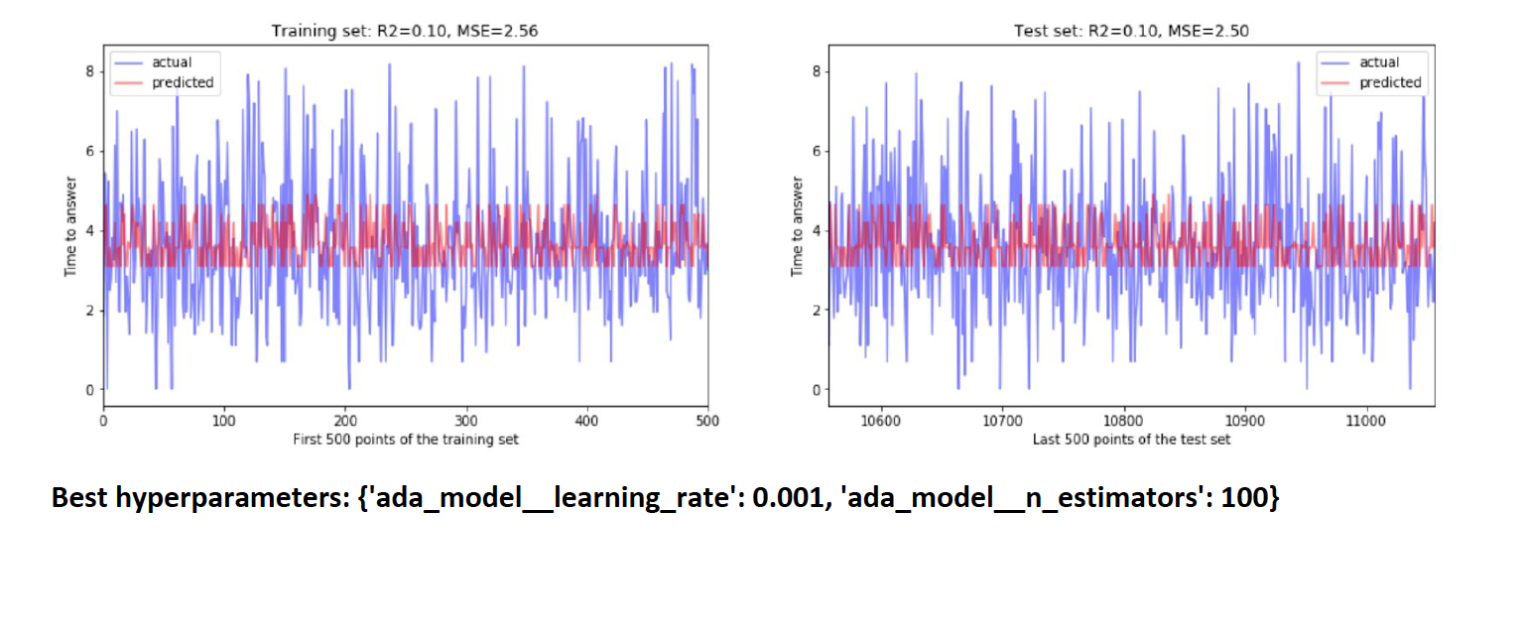
Adaboosting:

Slide 20
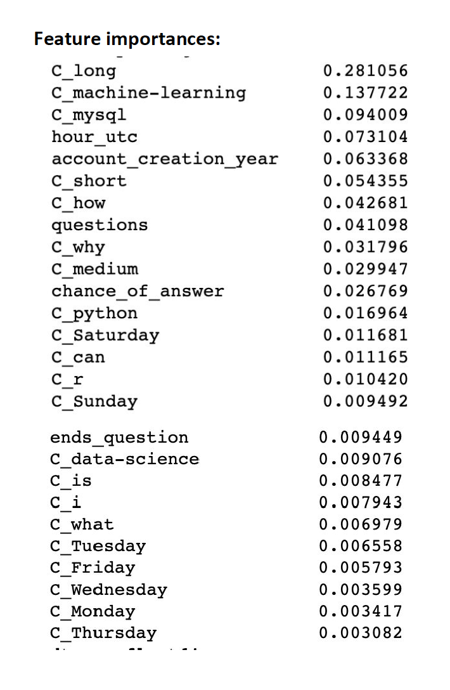
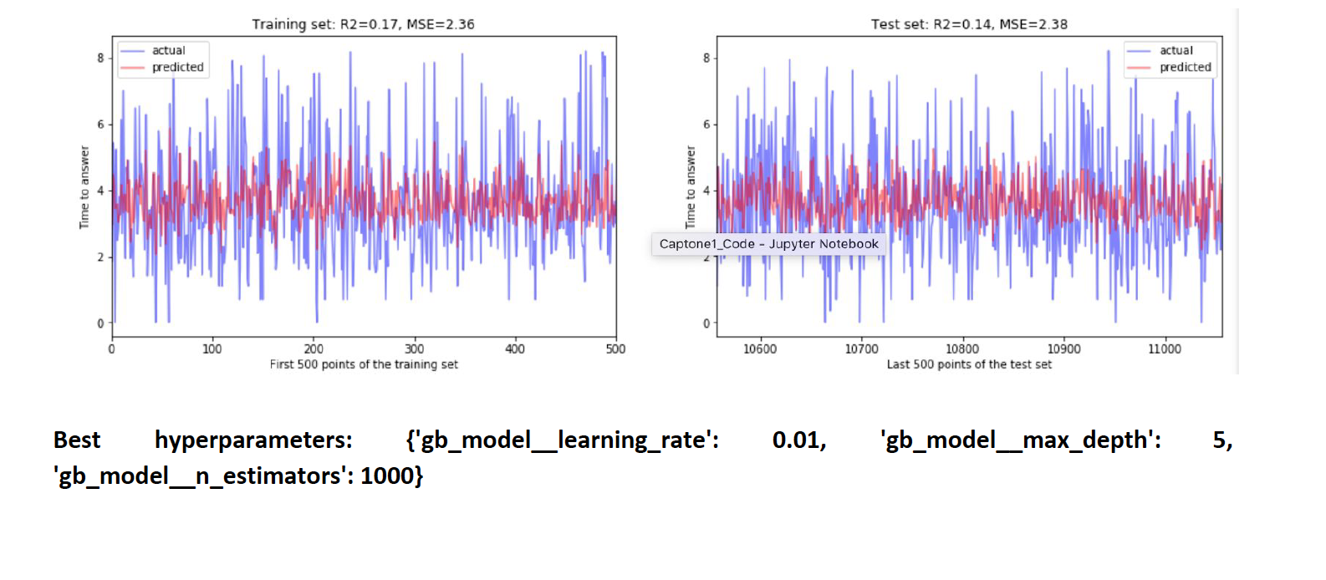
Gradient Boosting:

Slide 21
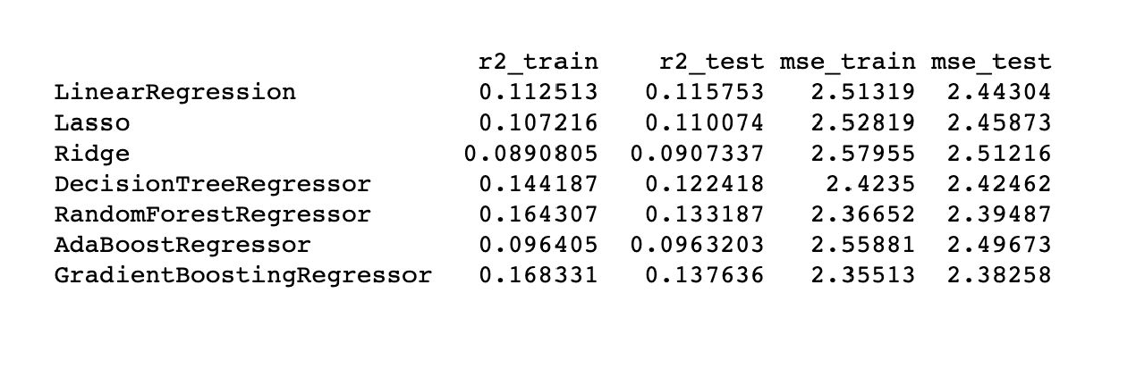
Model Metrics
Gradient boosting algorithm displays the highest accuracy with the highest R-squared value and lowest mean squared error, for both train and test sets
Took almost 5.5 hours to complete
Random Forest model shows only 1.2% decrease in accuracy (w.r.t MSE) but was executed in 5 mins
Top three features that affect the time it would take for an answer for a particular question seems to be: length of the question, question tag and the time of day the question is posted, respectively

Slide 22
Conclusion
Stack Overflow is a platform used by millions of computer scientists worldwide, and usually post questions while working on a project, thus anticipating an answer as soon as possible
Successfully developed a model to predict the response rate for a question posted on Stack Overflow
Evaluated multiple supervised machine learning algorithms, and evaluated each model for accuracy and efficiency
The length of the question, question tag and the time of day the question is posted have the greatest impact on how long it would take to get an answer.

